Slide 1

CASE STUDY
BANGLADESH BANK CYBER-HEIST

Slide 2
1
TIMELINE OF THE ATTACK
2
ACCUSED OR SUSPICIOUS HACKING GROUP
AGENDA
3
VICTIMS
4
INVESTIGATION REPORT
5
CONCLUSION

Slide 3
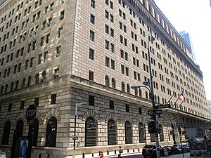
TIMELINE OF THE ATTACK
In February 2016, the world found out that hackers attempted to steal more than $1 billion from a Bangladeshi bank, only to be thwarted by a typo and only get away with $81 million.
WWW.ZPNET.COM

Slide 4

HACKING GROUP
While initially, everyone thought this was a bumbling hacker, it was later revealed that North Korea's elite hackers were behind the attempted cyber-heist.
WWW.WIKIPEDIA.COM

Slide 5
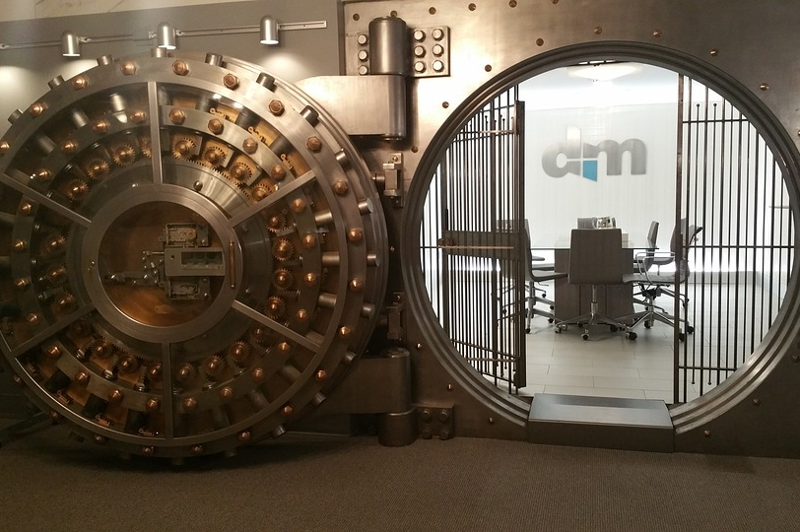
VICTIMS
The Bangladesh bank hack had a huge impact on the banking sector.
Perpetrators attempted to steal us$951 million from the Bangladesh bank's account with the federal reserve bank of new York.
WWW.WIKIPEDIA.COM

Slide 6
INVESTIGATION REPORT
BANGLADESH CENTRAL BANK
PHILIPPINES
UNITED STATES
FBI SUSPICION OF NORTH KOREA
Linked to Federal reserve bank of new York
Funds diverted to the Philippines was deposited in five separate Rizal commercial banking cooperation
FireEye’s Mandiant forensics division and world informatic cyber security
Federal prosecutors in the United States
www.Wikipedia.com

Slide 7
CONCLUSION
Decisions made in the wake of the attempted hack resulted in comprehensive security updates to SWIFT, the international transaction system for moving funds between different banks.
Second, the SWIFT organization also banned North Korea from its system, a decision that had repercussions in the years to come.
These two decisions together pushed Pyongyang hackers towards targeting cryptocurrency exchanges, from where they're believed to have stolen hundreds of millions of US dollars, money the North Korean state used to build up its nuclear weapons program.
WWW.ZPNET.COM

Slide 8

THANK YOU

